Slide 1
Unpacking .NET Core
Dmitriy Podrezov

Slide 2






EastBanc Technologies
CUSTOM SOFTWARE DEVELOPERS
200 employees (180 engineers) Certified Amazon - AWS Technology Partner
Engineers, PhD’s & scientists Certified Azure/Microsoft Partner of the Year 2014
Open Architecture Washington, DC Headquarters
Business Intelligence & Big Data
Content Management & Enterprise Portals
Identity & Access Management
Cloud Solutions, IoT & DevOps
System Integration & CRM Applications
Custom Mobile Solutions

Slide 3

Agenda
History and motivation
Platform overview
Components
Tools
Project types
.NET Foundation
Futures
Commitment

Slide 4


Slide 5


Slide 6
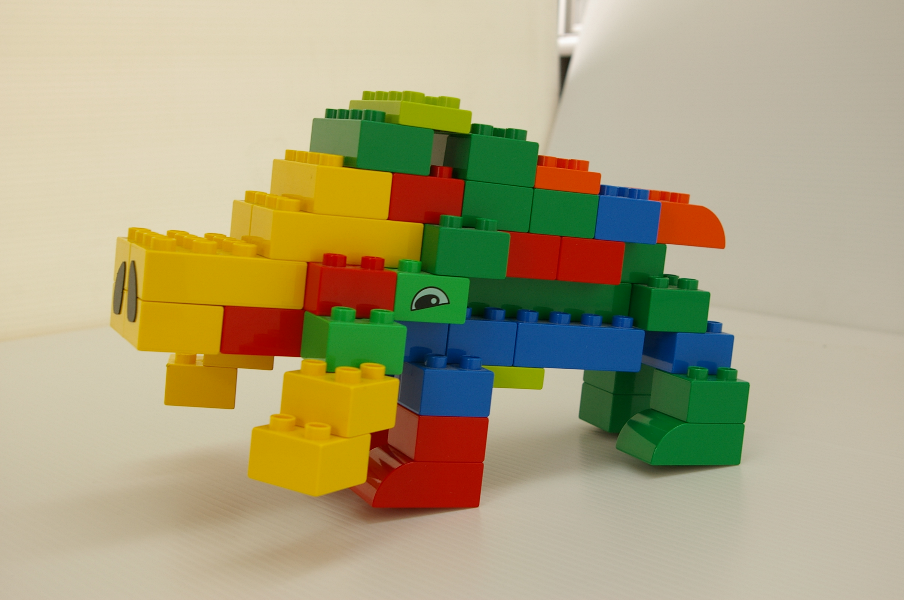
SharePoint?

Slide 7
History and motivation
Frameworks Mayhem
WebView/WebBrowser
Compatibility
Versioning
Support
Nuget
Core

Slide 8
Core Roadmap
Early 2014 – early work
Early 2015 - announce
Mid-2015 - Betas
Oct 2015 – Beta 8
Nov 2015 - RC1
May 2016 - runtime RC2, tools Preview1
6/27/16 - runtime RTM, tools Preview 2
11/16/16 – runtime 1.1, tools Preview 3
VS 2017 - Tools RTM

Slide 9
What’s new?
All of it!

Slide 10
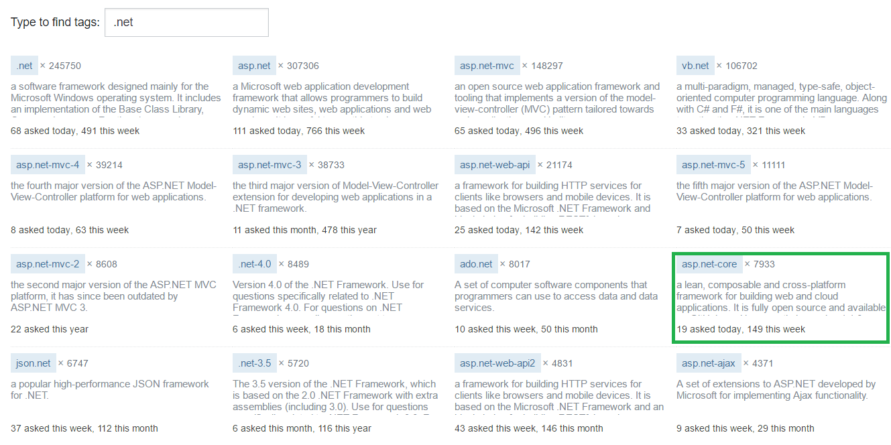
Not SO proof

Slide 11
Components
Core CLR
Core FX
Your App
dotnet Tool
Dev Tools

Slide 12
CLR
RyuJIT
Roslyn
Garbage Collector
Native Interop

Slide 13
WPF WinForms ASP.NET
.NET Framework
.NET Core
iOS Android macOS
UWP ASP.NET Core
.NET Standard Library One library to do it right it this time
Xamarin
Common Infrastructure Compilers | Languages | Runtime components

Slide 14
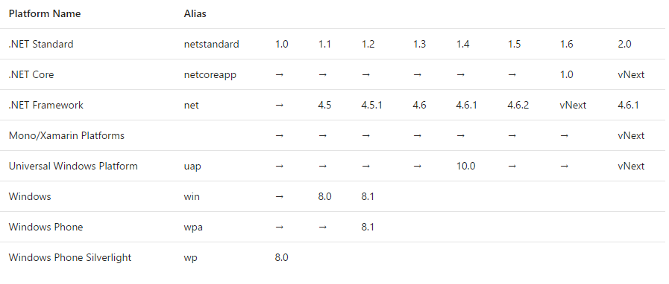
.NET Standard

Slide 15

Project.json v .csproj

Slide 16
.NET Native

Slide 17
Dotnet command
restore
-s <source>
build
--packages <path>
run
-o <path>
publish
-f <framework>
-o <path>
-f <feed>
--configfile <path>
-v <verbosity>
-b <path>
-f <framework>
-r <RID>
-c <configuration>
--version-suffix <value>
-no-dependencies
-c <configuration>
-p <path>
<runtime args>
test
--no-build
-b <path>
-c <configuration>
-s
--no-build
--version-suffix <value>
--version-suffix <value>
-o <path>
-b <path>
-f <framework>
-r <RID>
-c <configuration>
-o <path>
-b <path>
-f <framework>
-c <configuration>
pack
-r <RID>
--no-build
DOTNET_CLI_TELEMETRY_OPTOUT

Slide 18
IDE
Visual Studio 2017
Visual Studio 2015
Visual Studio Code
OmniSharp

Slide 19
Project types
UWP
Portable Library
ASP.NET

Slide 20
ASP.NET features ready Not ready yet
Runtime
OWIN
DI
MVC
Web Api
Razor
Identity
Entity Framework
Azure support
VS Online support
SignalR
Tools
Docs
VB.NET
Web Pages

Slide 21
What to look for
Dependency Injection
Configuration

Slide 22
Dependecy Injection
IServiceCollection
IServiceProvider
FromServicesAttribute
AddTransient
AddScoped
AddSingleton

Slide 23
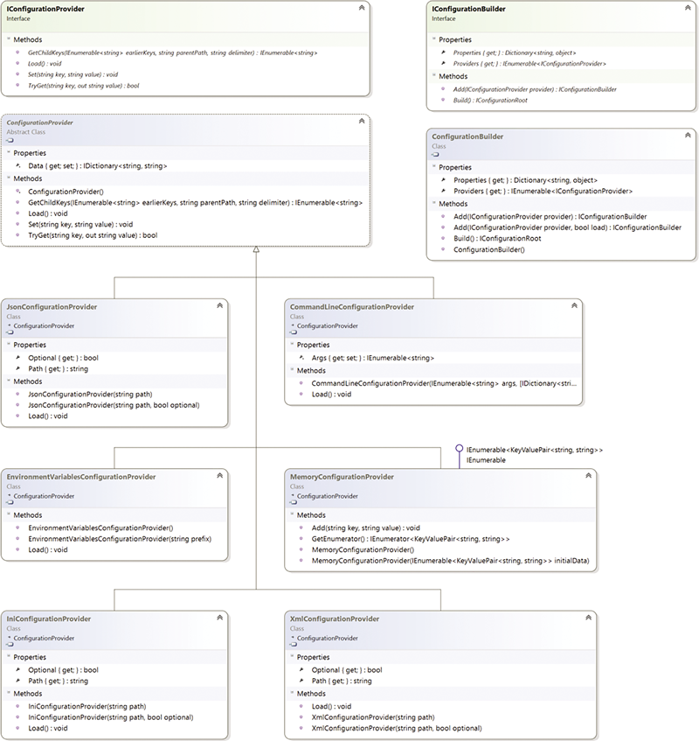
Configuration
ConfigurationBuilder
IConfigurationProvider
JSON by default
Options
Secrets

Slide 24
Entity Framework Core
.NET | .NET Core | UWP | OS X | Linux
SQL Server | SQLite | PostgreSQL | SQL Compact | DB2 | InMemory
Soon: MySQL | Oracle | Azure Tables | Redis
Most runtime/tools ready
Faster
Migration snapshot now stored in DB
Enable-Migrations obsolete

Slide 25
DEMO

Slide 26
.NET Foundation

Slide 27
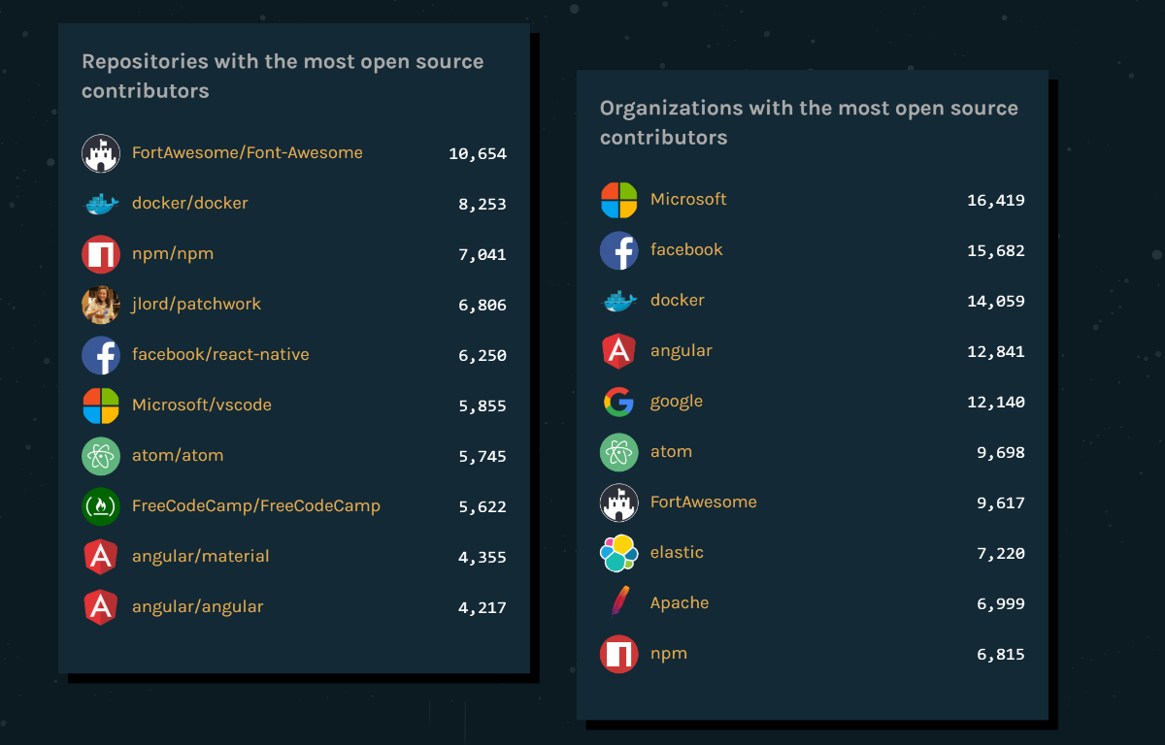
Microsoft contribution

Slide 28
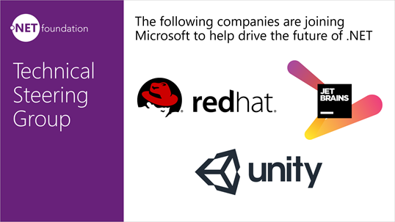


.NET Foundation Technical Steering Group

Slide 29
Do I migrate?
Library
ASP.NET
Modern app
Console app
Microservice

Slide 30
What next?

Slide 31
Repositories in need
dotnet/wcf
Azure/azure-sdk-for-net
SignalR/SignalR
OfficeDev/Open-XML-SDK
Microsoft/msbuild
dotnet/roslyn

Slide 32
Hanc marginis exiguitas non caperet

Slide 33
Resources
dot.net
live.asp.net
github.com/dotnet/standard
github.com/ebt-techtalk/core
bit.ly/2fWwSGo .NET Core 1.1
bit.ly/2b1JoHJ .NET Standard

Slide 34
Questions?

Slide 35
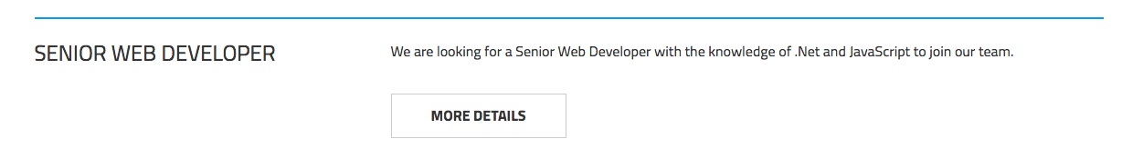
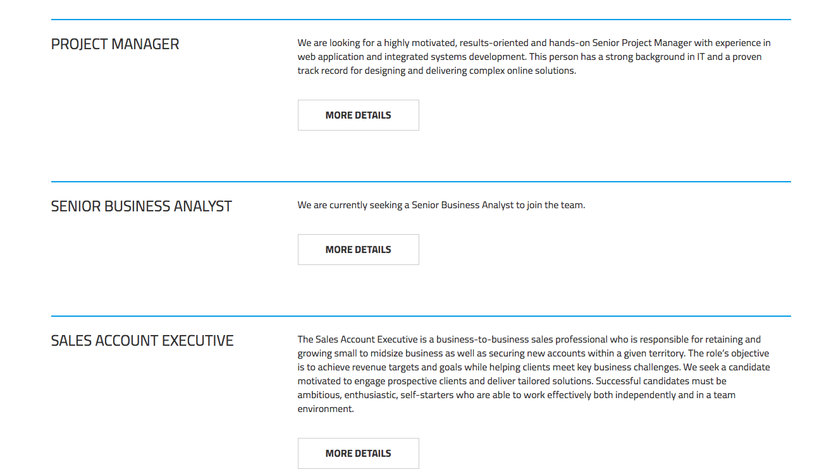
We are hiring:
http://www.eastbanctech.com/careers/vacancies

Slide 36
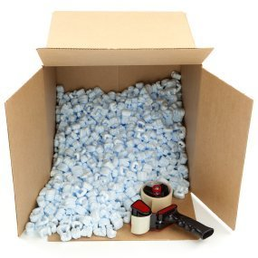
THANK YOU
Dmitriy Podrezov
@dmitrypodrezoff
dpodrezov@eastbanctech.com
571-598-7316

